Slide 1
A presentation on
The Rise of Robots and The Fall of Routine Jobs

Slide 2
Supervised by Professor Mohammad Lutfor Rahman. Department of Economics,
Jahangirnagar University.
Presented By Md. Rakib Hasan Piyal Roll: 1245 Department of Economics, Jahangirnagar University

Slide 3
Authors
Gaaitzen J. de Vries; Faculty of Economics and Business, University of Groningen, the Netherlands
Elisabetta Gentile; Asian Development Bank, Philippines
Sébastien Miroudot; Organization for Economic Co-operation and Development (OECD), Trade and Agriculture Directorate, France
Konstantin M. Wacker; Faculty of Economics and Business, University of Groningen, the Netherlands

Slide 4
Introduction:
This paper studies the impact of robot adoption on labor demand, finding it reduces routine manual jobs in high-income countries but not developing ones. Robots substitute for tasks, but the technical feasibility for this varies across countries and industries.

Slide 5
Background
This paper investigates the impact of industrial robots on employment within different job types across 37 countries between 2005-2015.
Technical feasibility: Industries' potential for robot-replaceable tasks (measured by routine task share).
Employment effects: How robot adoption impacts employment share in different occupational groups

Slide 6
Data source and descriptive analysis
This study combines two datasets to analyze the impact of robot adoption on task composition (routine vs. non-routine, manual vs. analytic) within 40 countries from 2000 to 2015
 | Routine | Non- Routine
Manual | Production workers, Agricultural workers, Others | Support-services workers, Drivers
Analytic | Administrative workers | Legislators, Managers, Engineers, Health professionals, Teaching professionals, Other professionals, Sales workers

Slide 7
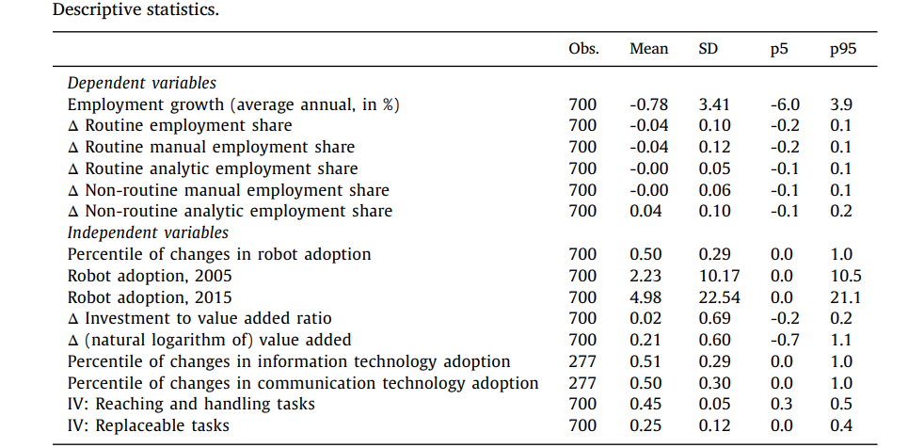
Data source and descriptive analysis

Slide 8
Theoretical framework Traditional model
Robots complement workers, enhancing productivity by automating routine tasks.
This increases demand for workers in non-routine tasks (e.g., creativity, problem-solving).
Robot adoption is more likely in countries with high wages and lower costs.

Slide 9
Theoretical framework Expanded model
Robots can also replace workers in a widening range of tasks, lowering labor demand.
They create new tasks for humans (e.g., programming, maintenance).
The impact on labor demand depends on the balance between displacement and new tasks.
Technical feasibility of automation varies by industry (e.g., garments vs. cars).

Slide 10
Theoretical framework Additional Factors & Empirical Analysis
Rising wages and slowing population growth can drive robot adoption even in low-wage countries like China.
Government policies and subsidies can encourage robot development and adoption.
Advanced robotics can reduce production costs, potentially reversing offshoring trends.

Slide 11
Methodology
Ordinary Least Squares (OLS): It is a statistical technique used to estimate the relationship between robot adoption (independent variable) and employment (dependent variable).
2SLS (Two-Stage Least Squares): This technique uses instrumental variables, which are correlated with the independent variable but not with the error term.

Slide 12
Findings
Robot adoption decreases the employment share of routine manual jobs, but this effect is primarily observed in high-income countries.
Emerging market and transition economies show no significant relation between robot adoption and routine manual employment.
This suggests that technical feasibility and economic considerations shape the employment impact of robots.
Overall, the paper sheds light on the nuanced impact of industrial robots on job landscapes, highlighting the importance of task characteristics and economic context.

Slide 13
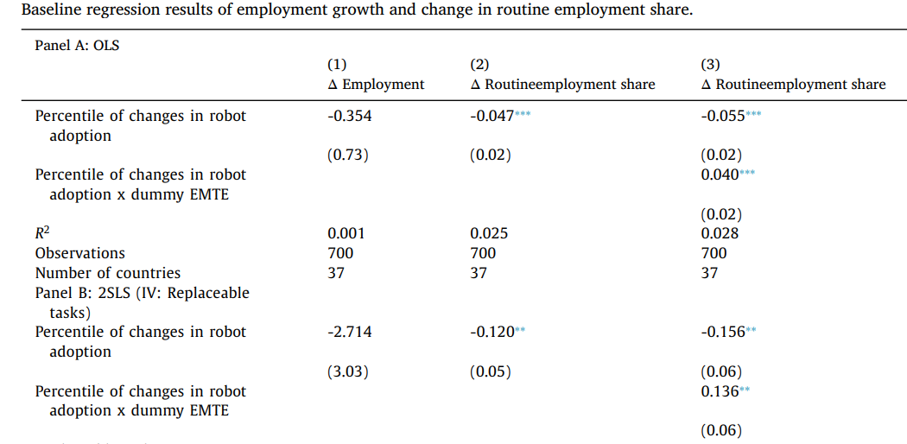
Econometric Findings

Slide 14
Robustness and heterogeneity
Controlling for ICT investment: Including this variable slightly reduces the negative estimated coefficient for robot adoption but it remains statistically significant.
Outlier countries: Ireland, Lithuania, Latvia, and Portugal are excluded due to potential influence on results.
Outlier sectors: Electricity, gas, water, and education/R&D sectors are excluded due to potential influence on results.
High-robot countries and industries: Excluding major robot-adopting countries and industries does not affect the main results.

Slide 15
Robot adoption and production worker
-Production workers are categorized as having high routine-manual tasks
-The study focuses on 7 specific production worker occupations in 24 countries to address this issue.
-They find a significant negative relationship between robot adoption and the change in employment share of these production workers.
-Results hold true using different methods to measure routine task intensity, further supporting the conclusion.

Slide 16
Controlling for long-term industry trends
Concern: Robot adoption might simply correlate with long-term trends of declining routine tasks, not directly causing it.
Challenge: Data on occupations and robots starts in 2000, when robots were already increasing.
These provide strong evidence that the observed negative relationship between robot adoption and routine employment is not solely driven by pre-existing trends or industry dynamics

Slide 17
Global developments in robot adoption
This section investigates the potential link between robot adoption and reshoring.
Both measures show a negative relationship between robot adoption and the share of routine jobs in Emerging Market and Transition Economies (EMTEs).
This suggests that global automation trends, not just local adoption, can impact EMTE labor markets.
Interestingly, the positive effect of being an EMTE disappears when considering global robot adoption trends.

Slide 18
Limitations
This paper has only worked with data from 2005 to 2015.
Here robotics has been only discussed in industrial perspective.
Only developed countries economy is discussed here.

Slide 19
Further study scopes
We can use data after 2015 for the research to get updated information.
There is a scope to do research about Robotics for developing countries.
Further research can be done on automation.
Medical robots, logistics handling robots, delivery means of drones are very much important for further research.

Slide 20
Conclusion
Increased use of robots causes positive changes in the employment share of analytic jobs and negative changes in the share of manual jobs.
The patterns documented are robust to instrumental variable estimation and the inclusion of various control variables, but differ across levels of economic development.

Slide 21
THANK YOU

